Slide 1



College English Writing 2
Course Description
Feb. 24, 2020

Slide 2
Things to do today
Self-introduction
Course Description
Requirements

Slide 3
My Name:
English Name:
Phone number:
QQ:
Email：

Slide 4

Learning Objectives
To be able to write 5 patterns of essays . (exemplification/narration/cause & effect/comparison/argument).
To be able to write and speak following “point+support” pattern.
To improve critical thinking & expand vocabulary
To improve listening& spoken English

Slide 5
Course Overview
2 periods/week✖️16 teaching weeks=32 periods American College Writing (ACW)+New Horizon English (NHE)
Online teaching+Online self-learning
Platform: laptop: http://dlut.fanya.chaoxing.com (recommended)
smartphone: 学习通

Slide 6

Textbooks
New Horizon College English 3 (Reading)
Comprehension (Ideas)
Organization
Vocabulary
Critique
Unit 1 Never, never give up
Unit 4 The surprising purpose of travel
Unit 5 Will you be a worker or a laborer?)
Unit 8 The art of parenting
Unit 2 Swimming through fear

Slide 7

Textbooks College Writing skills with readings
2019
semester 1
Essay Writing 1. An introduction to writing 2. The writing process 3. The First and Second Steps in essay writing 4. The third step in essay writing 5. The fourth step in Essay writing 6. Four bases for revising essays
Sentences Skills 1. Grammar 2. Mechanics 3. Punctuation 4. Effective word choice

Slide 8
Textbooks College Writing skills with readings
2020
semester 2
Essay Development 1. Chapter 10 Exemplification 2. Chapter 12 Cause and/or Effect 3. Chapter 13 Comparison and/or Contrast 4. Chapter 16 Argument 5. Chapter 9 Narration

Slide 9
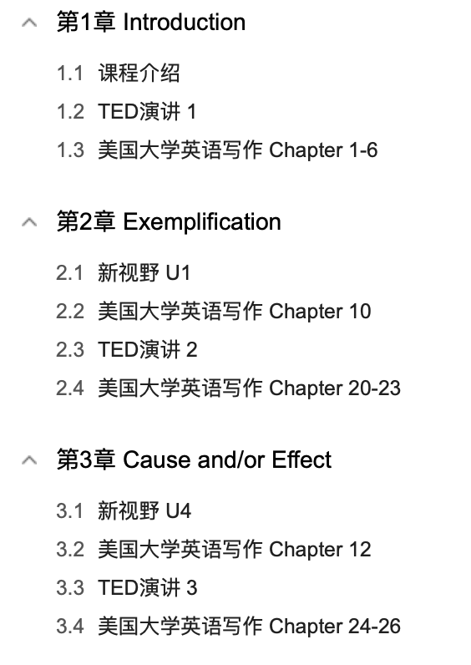
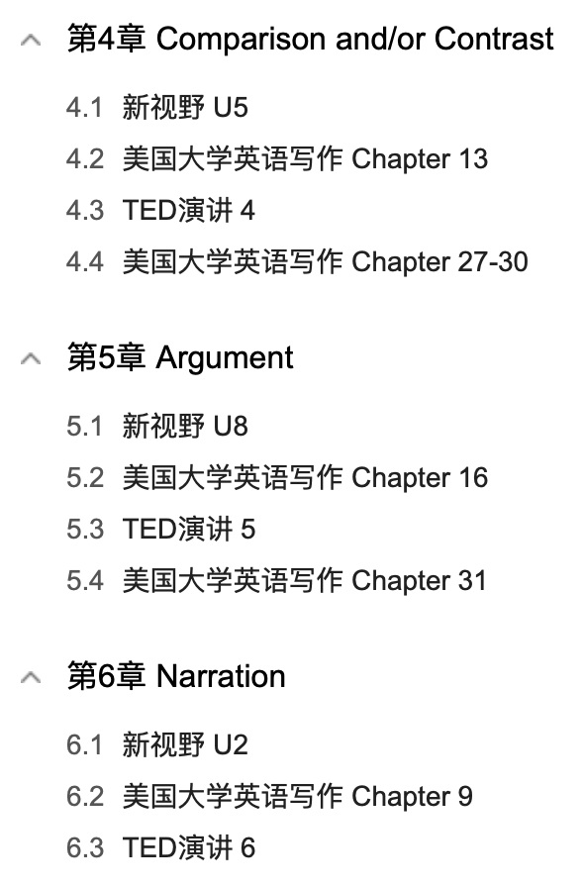

Slide 10
Flowchart of activities in one section
New Horizon English (Online)
Group Discussion (unit-related topic)
Warm-up (online video)
Structure analysis (online video)
Posts (choose one to answer)
New Horizon English (Offline)
Text reading
Vocabulary
Unit Exercise (words in use, expressions in use, Banked cloze)
Outline writing
American College Writing (Online)
Group Discussion (Outline writing)
Writing Skills learning (Online video)
American College Writing (Offline)
Professional essay reading
Reading exercises
Theme writing of the professional essay
TED Speech (Online resources)
Group Discussion (Theme writing of the p~ essay)
Ted speech listening
Ted speech exercise
Review writing skills (Online videos)
offline
Review everything learnt in this section
Discussion preparation (unit-related topic)

Slide 11
Assessment
Online learning | 30% | Attendance, Completion of online tasks (videos and posts) | W1-W16
Group Discussion | 10% | Related to the topic of each unit | W1-W16
Homework | 10% | Words in Use, Expressions in Use, Banked Cloze | W1-W16
Essay Writing | 20% | Essay writing test 1 10% | W2
 |  | Essay writing test 2 10% | W9
Final exam | 30% | Listening+Reading+Vocabulary | W17

Slide 12
Requirements
Be punctual
Be organized
Be self-disciplined
Finish online tasks before deadlines
Make full preparation before discussion.
Present your opinions in about 2 minutes.
Focus in class, and participate in discussion initiatively.
No inappropriate expressions in class, nor irrelevant words.

Slide 13
Questions?

Slide 14


